Slide 1













PREDICTIVE MODELING- WEEK-1

Slide 2




DSBA CURRICULUM DESIGN
CORE COURSES
DOMAIN APPLICATIONS
FOUNDATIONS
Python for Data Science
Advanced Statistics
Finance and Risk Analytics
Statistical Methods for Decision Making
Data Mining
Predictive Modelling(Week-1/
⁵⁾Machine Learning
Marketing and Retail Analytics
Time Series Forecasting
Data Visualization

Slide 3


LEARNING OBJECTIVE OF THIS MODULE
Linear Regression
Logistic Regression
Linear Discriminant Analysis

Slide 4

LEARNING OBJECTIVES OF THIS SESSION
Multiple Linear Regression
Concept of R²

Slide 5











TRY ANSWERING THE FOLLOWING
What is the equation of simple linear regression?
Can we have >2 independent variables in simple linear regression?
Name few techniques to deal with multicollinearity in a data.

Slide 6

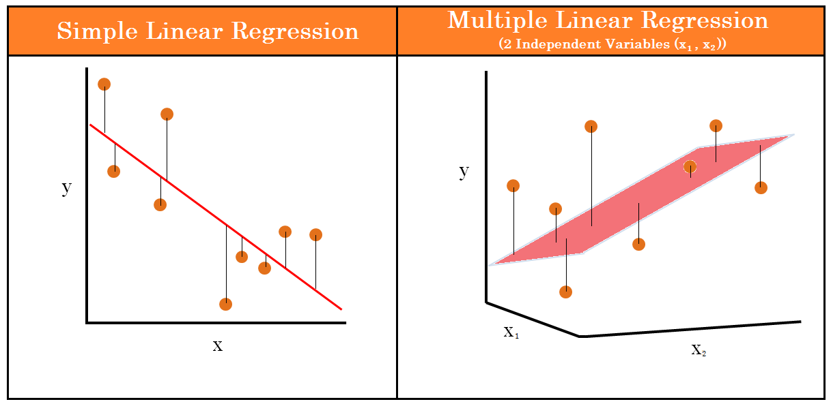
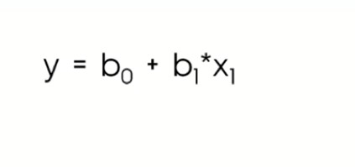
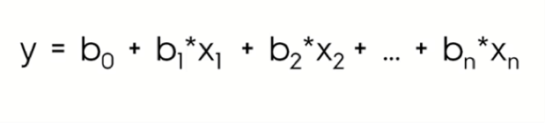
BROAD OVERVIEW

Slide 7

Industry Application - Linear Regression in Sports Analytics
Sports analytics is a booming field. Owners, coaches, and fans are using statistical measures and models of all kinds to study the performance of players and teams.
Billy Beane the manager of Oakland As met Peter Brand, a young Yale economics graduate with radical ideas about how to assess player value. Rather than relying on selector’s experience and intuition, Brand uses Linear Regression, selecting players based on their on- base percentage (OBP) while ignoring their perceived weaknesses. Brand and Beane use this methodology to hire undervalued players.
With one third the budget Billy Beans’ team performed at par with the highest paid teams. This led to evolution of a new stream of Analytics known as Sabermetics.
You may watch the Brad Pitt starrer Moneyball for Reference.
Reference:https://en.wikipedia.org/wiki/Sabermetrics

Slide 8
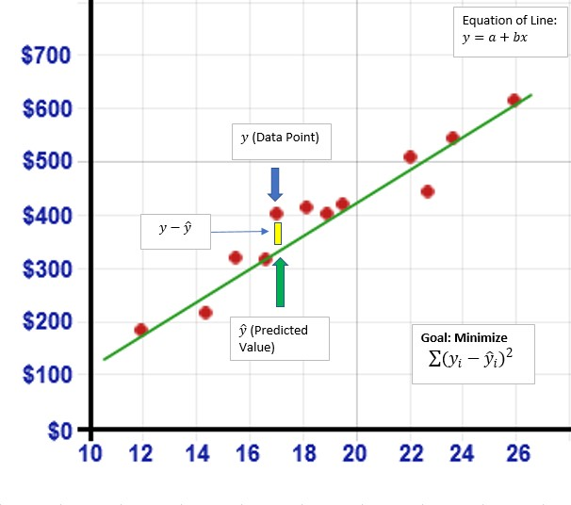
Industry Application - Linear Regression in Financial Markets
The financial performance of a company is a primary concern for every stakeholder especially for investors. The measurement of the financial health of a company through the reported financial statements gives a qualitative analysis of the company’s position as well as an account of how the company has utilised its capital in production.
These Financial Statements can be used to derive critical ratios that are broadly divided into following categories:
Liquidity ratios
Leverage ratios
Efficiency ratios
Profitability ratios
Market value ratios
We can obtain these ratios and the corresponding stock prices of various listed companies to create a Linear Regression model which predicts the stock price given we know the ratios.
Reference: https://pdfs.semanticscholar.org/0a82/305452d2fa7cdca91bdbbe6f409905ace42a.pdf

Slide 9

CASE STUDY - Price Prediction(Airbnb)
Airbnb, Inc is an online marketplace for arranging or offering lodging, primarily homestays, or tourism experiences. Airbnb has close to 150 million customers across the world. Price is the most important factor considered by the customer while making booking into a property. Strategic pricing of the properties is important to avoid losing customers to the competitors.
We have a data of 74111 Airbnb properties across the nations. Based on this data build a simple and multiple linear regression model to predict the strategic pricing of a new listed property on Airbnb.

Slide 10











ANY QUESTIONS

Slide 11


Apply Data Science at your workplace to gain some instant benefits:
Get noticed by your management with your outstanding analysis backed by data science.
Create an impact in your organization by taking up small projects/initiatives to solve critical issues using data science.
Network with members from the data science vertical of your organization and seek opportunities to contribute in small projects.
Share your success stories with us and the world to position yourself as a subject matter expert in data science.

Slide 12
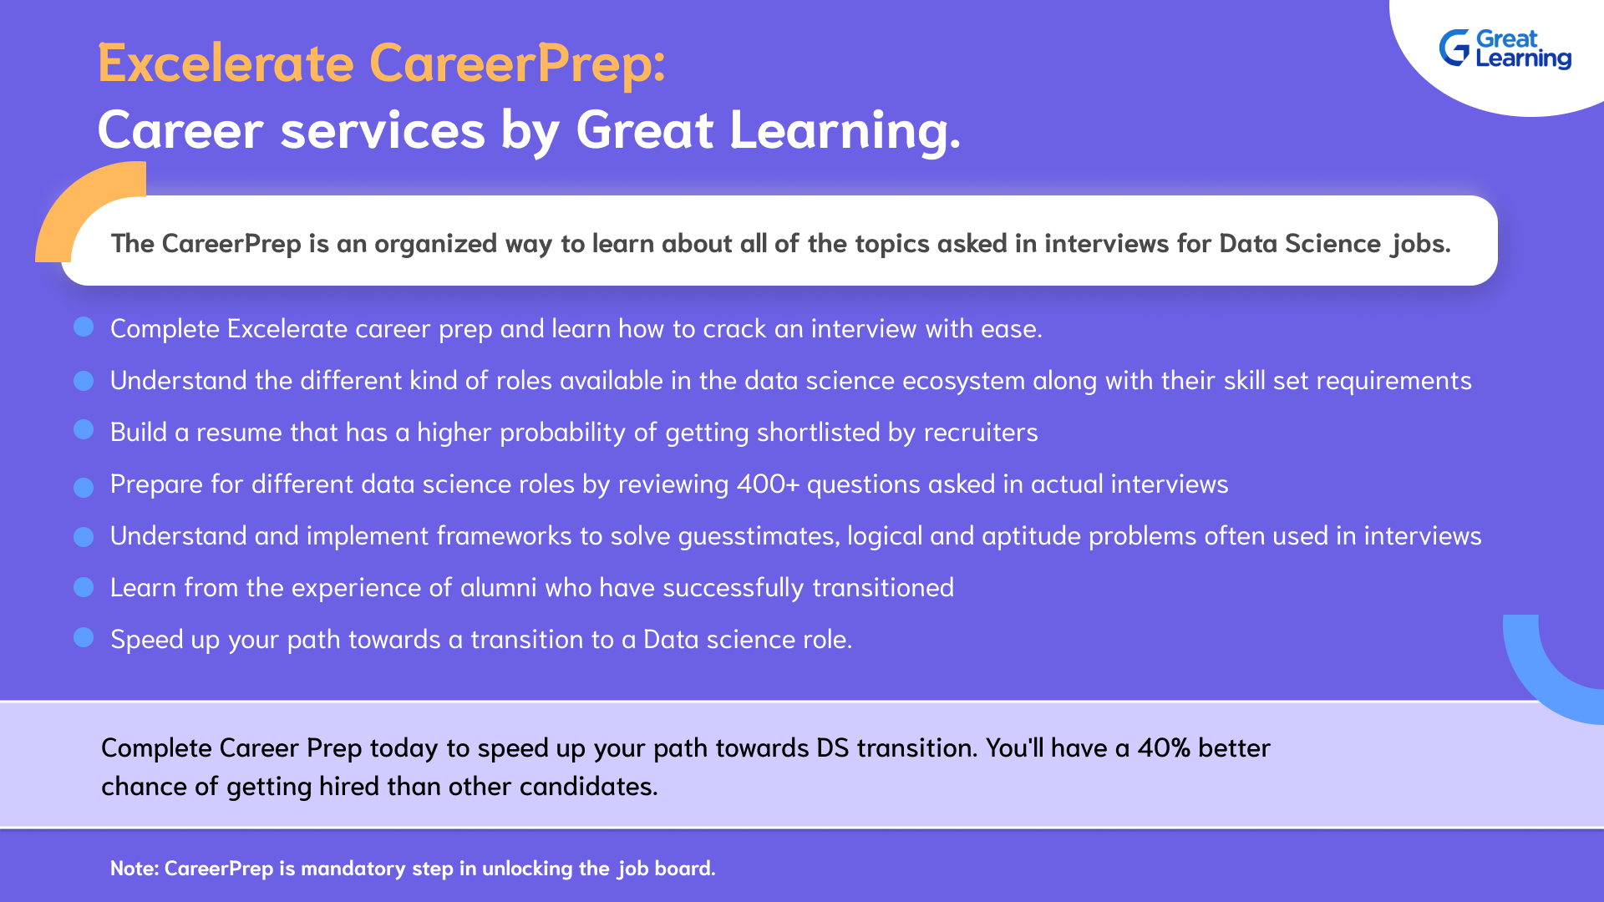

Slide 13

HAPPY LEARNING
Proprietary content. ©Great Learning. All Rights Reserved. Unauthorized use or distribution prohibited.

